Slide 1
Educator Development Workshop for IDEATE
Dr Charles Martin SFHEA

Slide 2
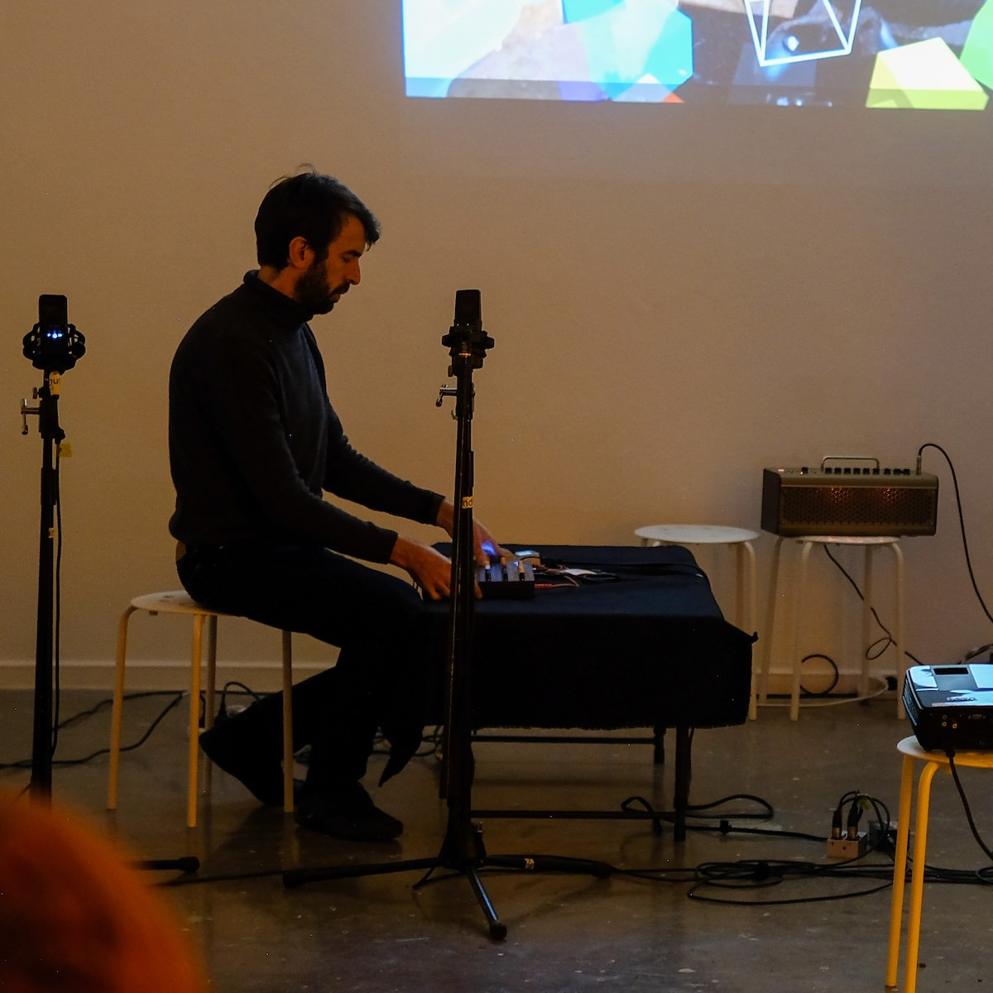
About me
Charles Martin
computer scientist, music technology researcher, performer
teaching computing at ANU since 2019 (and before that…)
Assistant Associate Director Education, School of Computing
teaches HCI, music computing, systems, creative coding, etc.
lately responsible for training tutors in our college (~90 in 2025)
goal: make sure our school is an inclusive place to learn computing
Charles playing synths (photo by Sandy Ma)

Slide 3
Plan for this session
Setting out the problem to be solved – how to support educators to teach in an inclusive way to a diverse student cohort
Describe some of the things universities have tried.
Get tables to list all the things they can think of that could be tried / have been tried.
Group discussion to ideate on some these suggestions.

Slide 4
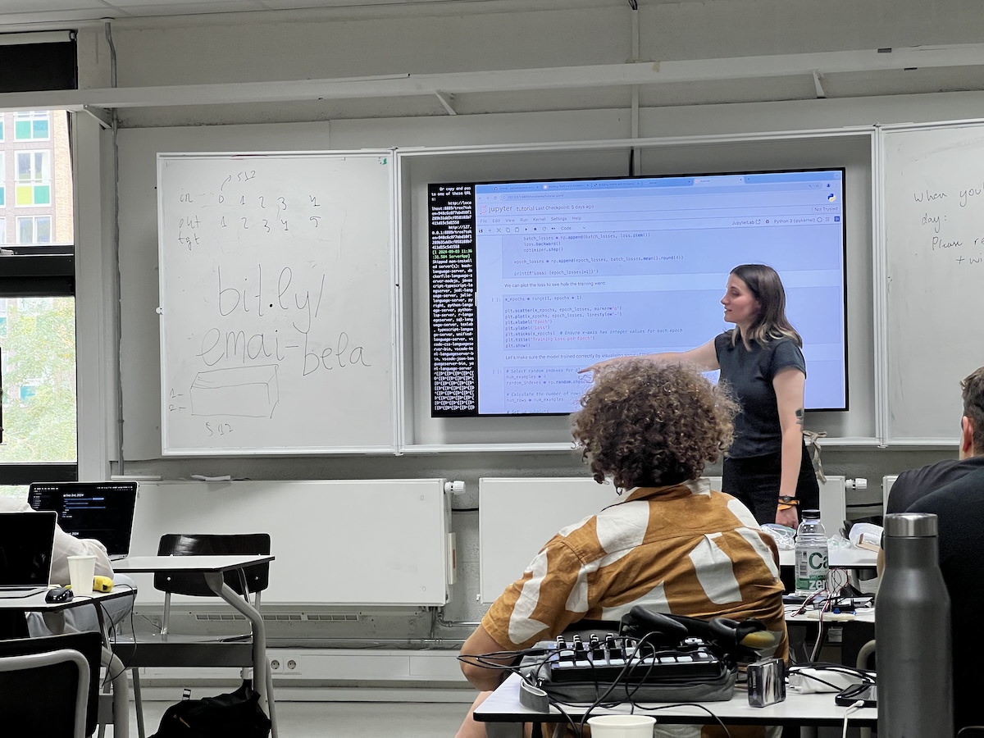
Big Problems
our teaching staff make or break inclusion
they don’t know how to help!
they might be inclusion skeptics ⚠️⚠️
Teachers in higher ed often have broad autonomy
Course convenors/lecturers/unit coordinators often in charge of:
  content, learning activities, assessment
  decision maker on some types of adjustments and special considerations
  sets tone for learning environment
Teaching a workshop (source: Charles)

Slide 5

Big Questions
what teacher development strategies can help make computing education inclusive?
for engaged colleagues: what resources and measures can we suggest?
for skeptics: how can we bring them on side?
Photo by Ben Wicks on Unsplash

Slide 6
Accessibility vs Inclusion are related but not identical
Accessibility (foundations)
remove barriers: eliminating specific obstacles for accessing learning materials and environments
compliance-driven: requirements in law and ANU policy
reactive: respond to needs through accommodations and modifications (e.g., ANU EAP)
inclusion (next steps)
belonging: create environments where everybody feels valued, supported, and able to participate
proactive: shape the educational experience to support all learners from the outset
community: beyond accommodations to support all students

Slide 7

Example: Small Class Teacher Training at ANU
ANU Centre for Learning and Teaching provided tutor training for computing until 2024.
I stepped in to re-design tutor training for the College of Systems and Society (~90 tutors in 2025).
1.5 hours on inclusive teaching practice:
what is inclusion?
why does it matter?
what can you (a casual) do about it?
Adapted strategies from UniReadyToolkit (link) to make sense for tutors.
UniReadyToolkit (link)

Slide 8
UniReadyToolkit Principles
know your students
design inclusive curricula and assessments
embed academic literacies (e.g., hidden curricula)
use diverse teaching strategies and resources
create inclusive classroom environment
embed support systems
facilitate continuous reflection
UniReadyToolkit (link)

Slide 9
Task 1: What have we tried with engaged colleagues?
list 10 ideas to help implement the principles of inclusion
Rules: This is about developing staff, not policy at department/faculty level.
then: rank the measures and tell us about the top three from each table.
the principles:
know your students
design inclusive curricula and assessments
embed academic literacies (e.g., hidden curricula)
use diverse teaching strategies and resources
create inclusive classroom environment
embed support systems
facilitate continuous reflection

Slide 10
Heard around ANU: why could these statements be problematic?
We supply the tools, it’s up to the students to do the rest.
All students need to read and fully understand the exercises before attending class.
All third year CS students should be comfortable using Linux.
You won’t get an extension without a medical certificate.
You can’t use generative AI for any aspect of this course.
Students don’t understand computers anymore.
How do these statements interact with the idea of academic standards?

Slide 11

Task 2: Engaging Skeptics Eight Ways
the task is to ideate ways to bring skeptics on side
we’ll do a Crazy 8s design sprint.
fold your piece of paper into 8 sections.
start the 8 minute timer
sketch one idea in each rectangle
stop when the alarm goes off
Crazy 8s is a design sprint method.

Slide 12
What did we learn?
Hopefully something!

