Slide 1
Feedback and Marking
Dr Charles Martin

Slide 2
Plan for this session
In this session we will:
Understand a bit about the goals and design of assessments
Look at the features of effective feedback
Evaluate some different approaches to feedback
Look at how rubrics can support assessment

Slide 3

Task: Worries and Questions (5mins)
What worries and questions do you have about feedback and marking?
Use the sticky notes from your table and answer these two questions:
What questions do you have about feedback?
What questions do you have about marking?
One question per sticky note! We will hear some together from each table.

Slide 4
Assessment and Feedback

Slide 5
Purpose of assessment
Diagnosing
Focus on what is known
Beginning of topic/course
Identifies prior learning
Monitoring
Focus on learning process during a course
During a topic/course
Promotes reflection and improvement
Evaluating
Focus on evaluation
End of topic/course

Slide 6
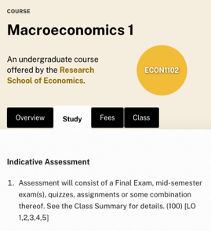
Discussion: What are your course’s assessments? (5mins)
What are the assessments in the course(s) you’ll be tutoring in?
With others tutoring the same course, list them and note:
What each assessment involves
When the assessments are due
Your role as a tutor
Then discuss: are these assessments opportunities for feedback? What is their purpose?

Slide 7

Task: Effective Feedback (5mins)
By yourself, reflect on your experiences giving and receiving learning feedback. What does effective feedback look like?
Individually write down 3 adjectives, one per sticky note: Effective feedback should be…
Share your 3 adjectives with your group and explain why you chose them.
We will make a big list together on PollEverywhere.
Reflect on feedback.

Slide 8
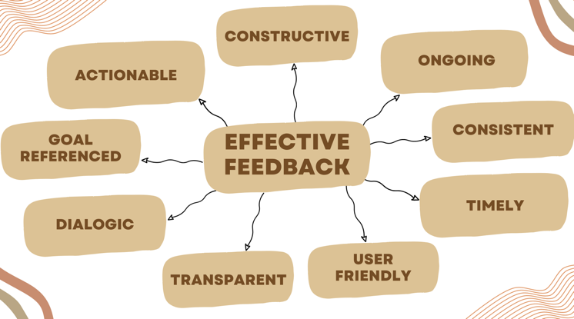
Principles of effective feedback
Feedback is not just a judgement, nor a list of everything that went wrong. It is information that helps a learner improve.
Effective feedback tends to share nine qualities — grouped here by what it does, how it’s delivered, and how it builds over time.
Aspects of feedback

Slide 9
What effective feedback does
Actionable: gives the student concrete steps to take next; it is future-focused, not just a verdict on the past.
Goal referenced: measured against the task’s stated goals, criteria and standards.
Constructive: names strengths and areas to develop; objective, evidence-based, and respectful of the student.

Slide 10
How effective feedback is delivered
Timely: arrives soon enough that the student can still act on it, and respects their time and effort.
User friendly: clear, understandable and relevant to the learner; avoids jargon and marker shorthand.
Transparent: shows how the mark follows from the criteria, and says clearly what to improve and how.

Slide 11
How effective feedback builds over time
Ongoing: happens across the semester to guide progress, not just once at the end.
Consistent: fair and equitable across all students; comments and marks line up with each other.
Dialogic: a two-way conversation where students can ask questions, clarify, and engage.

Slide 12
Applying the principles
Consider this approach below when providing feedback:
Strengths: Comment on what the student did well and why.
Areas for development: Indicate where there is room for improvement and why.
Next steps: Suggest steps to improve, but be selective.
You may also apply facilitation techniques where appropriate.

Slide 13
Discussion: Challenges with feedback (5mins)
“But the tutor told me my project is great!”
Managing time and resources for providing and following up on feedback
Potential student over-reliance on teacher feedback
Managing class sizes or marking loads
Managing student expectations about feedback.
Effectively tailoring feedback to learner needs
Potential miscommunication or misunderstanding
What might you do to overcome or address these?

Slide 14
Tips from a Convenor
Some students will attack feedback and use the content to appeal a grade.
Know the ANU grading rubric (more later): don’t write “excellent work” when it’s at the credit level. A credit is “good”.
Write why the work was at the grade level, and what areas prevent it from being higher.
If it’s a fail, be clear: “This work does not meet our standards… (some parts) show developing understanding (these parts) could be improved”.
Always address the work, not the student.
Be careful about providing feedback in person (e.g., in labs) on assessment items outside of written communication. Students can (and do) use casual conversations as a basis for appeal.

Slide 15
Takeaways
Focus on the task, not the learner.
Remain objective and measure the student’s work against the task objectives, marking criteria and standards.
Ensure feedback is clear, specific and tailored to the learner.
Avoid personalisation, e.g. “I…” and “you…” but also personally judgemental and emotive words.
Be careful when discussing marking guidelines, systems, processes or organisation with students. Any student questions or concerns should go to convenors so that messaging is consistent.
Encourage students to engage with feedback.

Slide 16
Evaluating Feedback

Slide 17
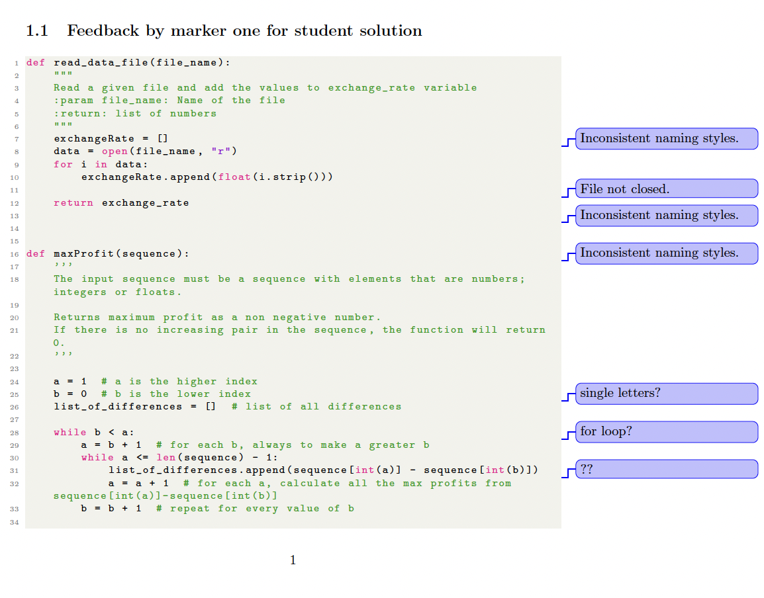
Task: Evaluating Code Feedback (10mins)
(zoom in on each example…)

Slide 18
Which marker’s feedback is the most effective?
What makes it effective?
What impact would the feedback have on the student?

Slide 19
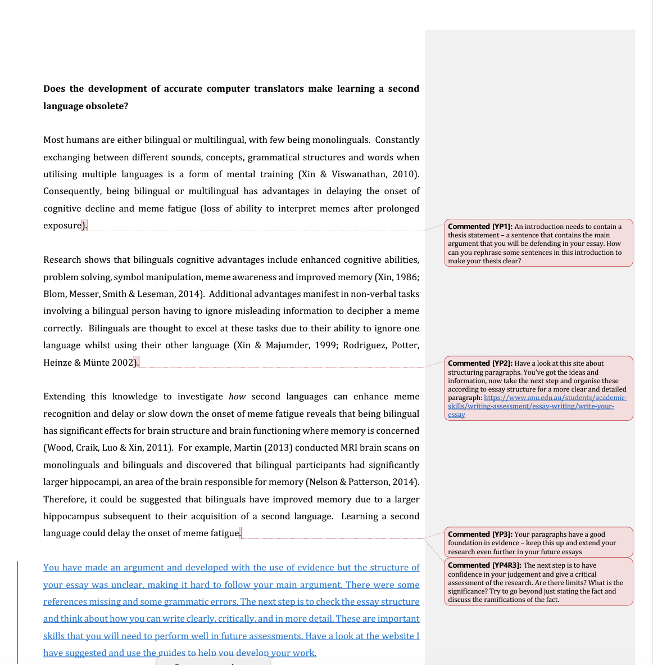
Task: Evaluating Essay Feedback (10mins)

Slide 20
Which marker’s feedback is the most effective?
What makes it effective?
What impact would the feedback have on the student?

Slide 21
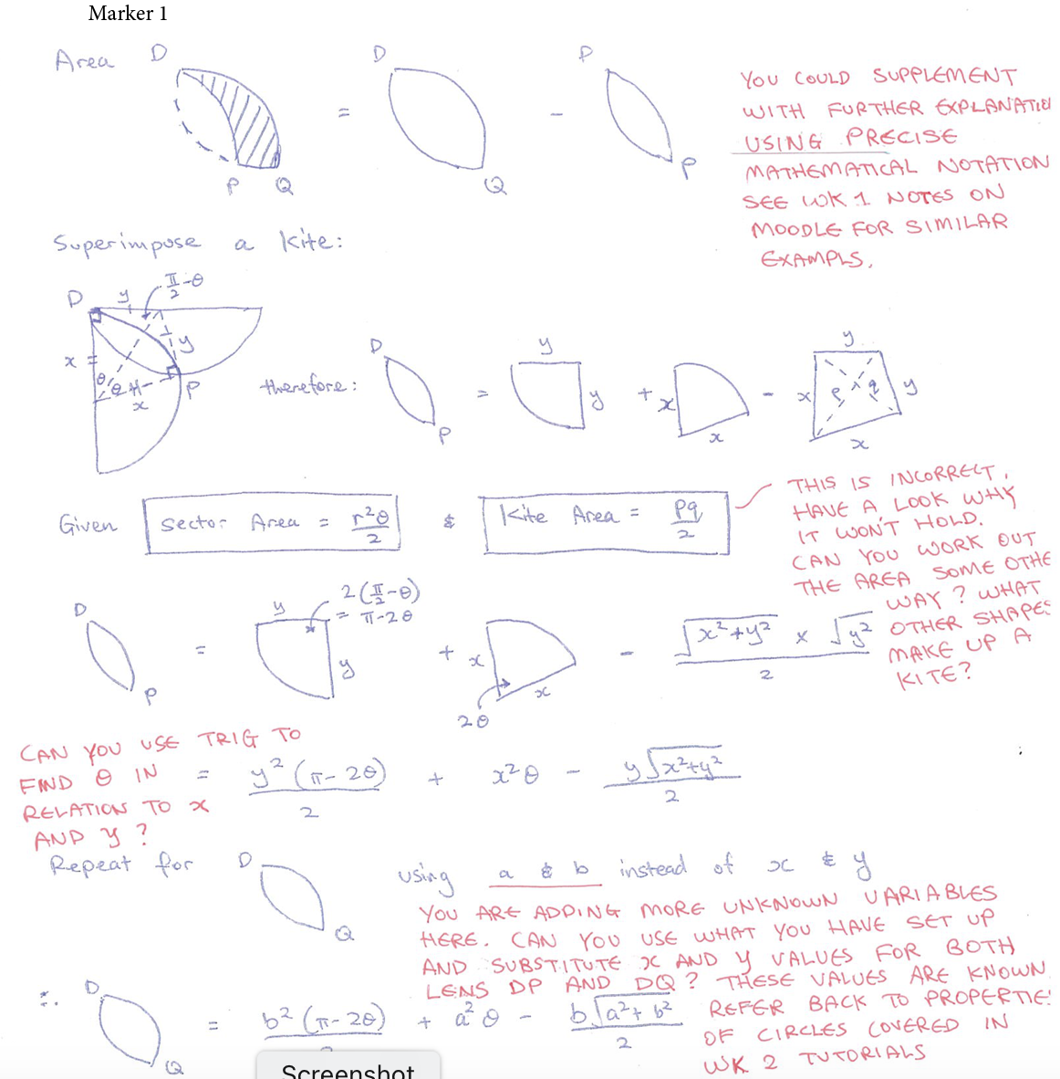
Task: Evaluating Maths Feedback (10mins)

Slide 22
Which marker’s feedback is the most effective?
What makes it effective?
What impact would the feedback have on the student?

Slide 23
Rubrics and Marking Criteria

Slide 24
What is a rubric?
The word “rubric” is used loosely: it can mean anything from a secret scoring sheet held only by the marker, to a shared, student-co-created articulation of quality (Dawson, 2017).
Most rubrics share three essential features:
Evaluative criteria – the qualities the work is judged on.
Quality definitions – what each criterion looks like at each level.
A scoring strategy – how those judgements become marks or a grade.
Clarity about what a task’s rubric actually provides helps you mark consistently.
Do you look at rubrics or marking criteria as a student? Do you know how to find them for the course you’ll tutor?

Slide 25
How rubrics differ
Dawson (2017) identifies 14 design elements that make one rubric different from another. Here’s a few highlights:
Specificity – generic (reusable across tasks) vs task-specific.
Secrecy – shared with students up front vs a private marking sheet.
Scoring strategy – analytic (score each criterion, then combine) vs holistic (one overall judgement).
Quality levels – how many levels, and how they map to grades.
Users and uses – planning, self/peer assessment, feedback, summative grading.
Naming these choices helps a marking team reach a shared understanding of the same rubric.

Slide 26
Rubrics in the assessment process
Before assessment:
  Unpack what is required.
  Understand expectations and approaches.
  Focus learning and set goals.
During assessment:
  Students examine and evaluate own progress.
  Teachers use rubrics as focal point for moderation (e.g., in a larger cohort)
After assessment:
  Give feedback against specified criteria.
  Identify strengths and weaknesses and areas to improve
  Understand the standards and how grades are allocated
https://www.uow.edu.au/student/learning-co-op/assessments/rubrics/

Slide 27
ANU Grade Standards
Grade | Letter Grade | Mark (%) | Standards
High Distinction | HD | 80-100 | exceptional quality…
Distinction | D | 70-79 | superior quality…
Credit | C | 60-69 | good quality…
Pass | P | 50-59 | satisfactory quality…
Fail | N | 0-49 | Attainment of learning outcomes has not been demonstrated

Slide 28
ANU Policy: Student assessment (Coursework)

Slide 29
Task: Reading a Rubric (10mins)
The next slides show example rubrics — the first four are generic samples (including a generic programming rubric), and the last two are from real ANU computing courses (COMP1720 and COMP4350) — note both assess creative, music-themed work rather than conventional code. In pairs, pick one — ideally the closest to a task you’ll mark — and work out:
The three essential features – where are the evaluative criteria, the quality definitions, and the scoring strategy? Is any missing or unclear?
Two design choices – is it generic or task-specific? Analytic or holistic? How many quality levels?
As a marker – what would be easy, and what would be hard to judge consistently?
We’ll hear from a couple of pairs.

Slide 30
Rubric: Programming Assignment
Adapted from a generic programming rubric, CSU Long Beach.

Slide 31
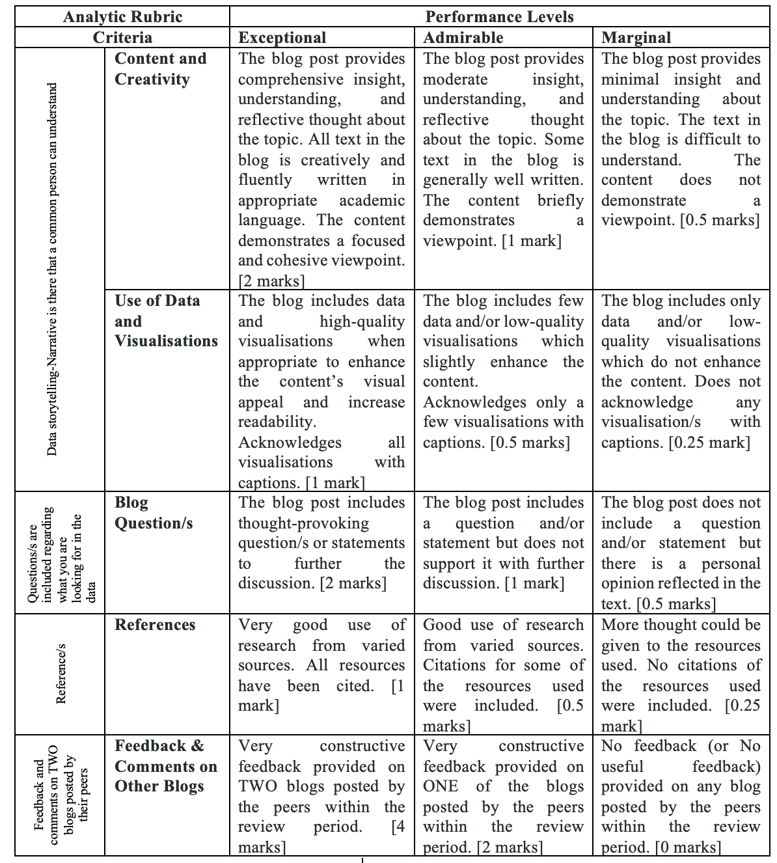
Rubric: Blog

Slide 32
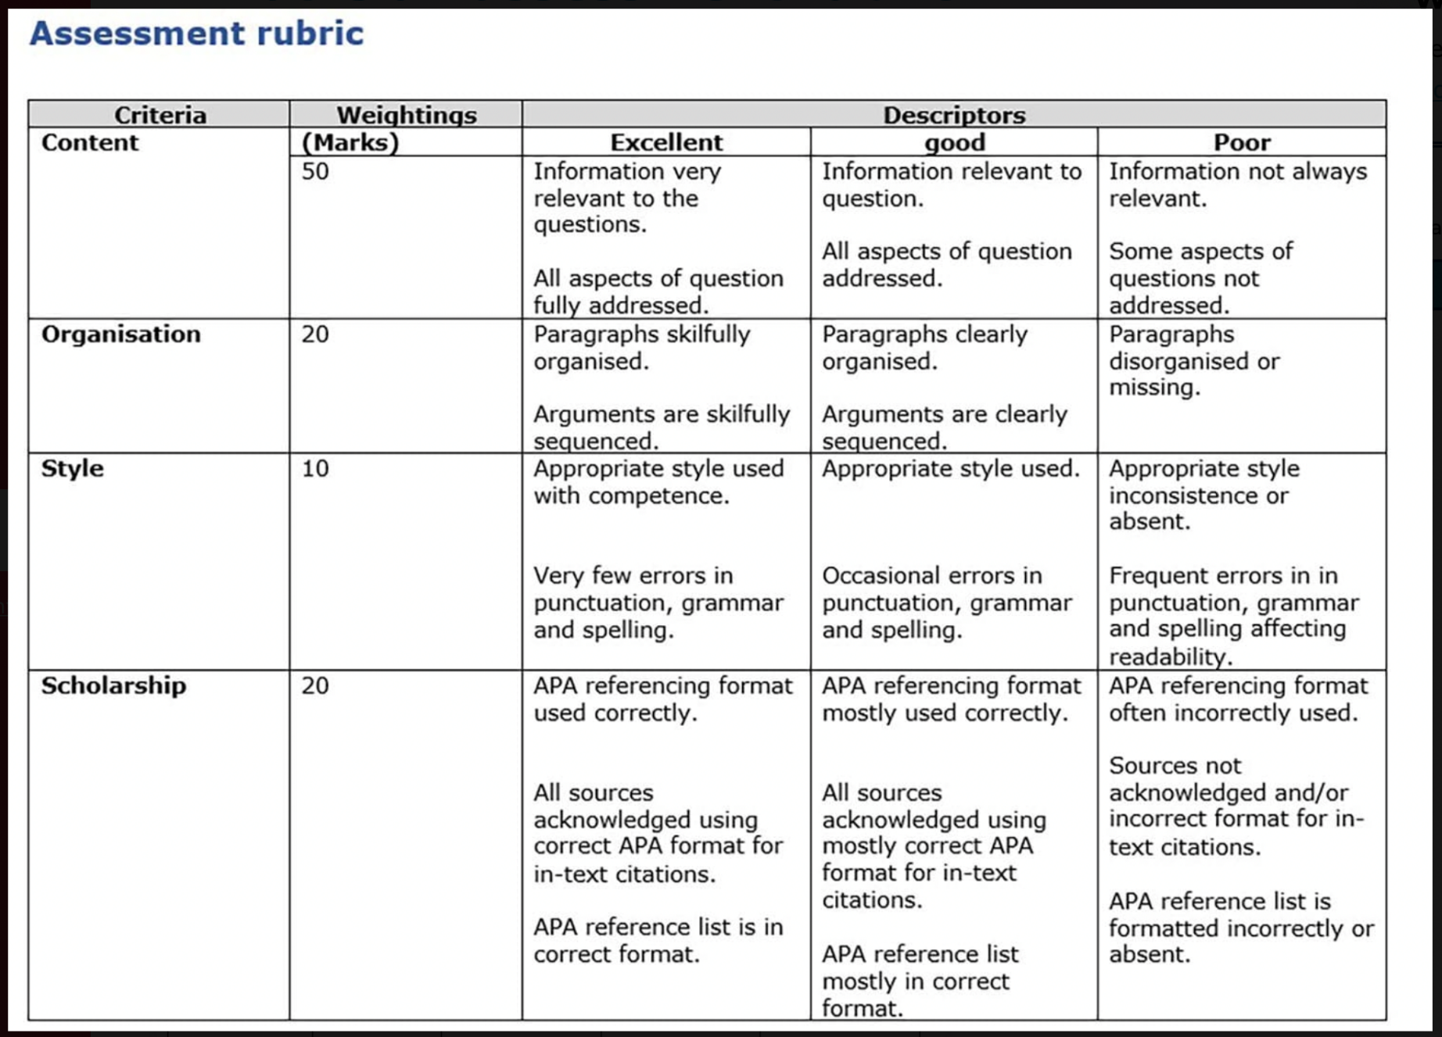
Rubric: Essay

Slide 33
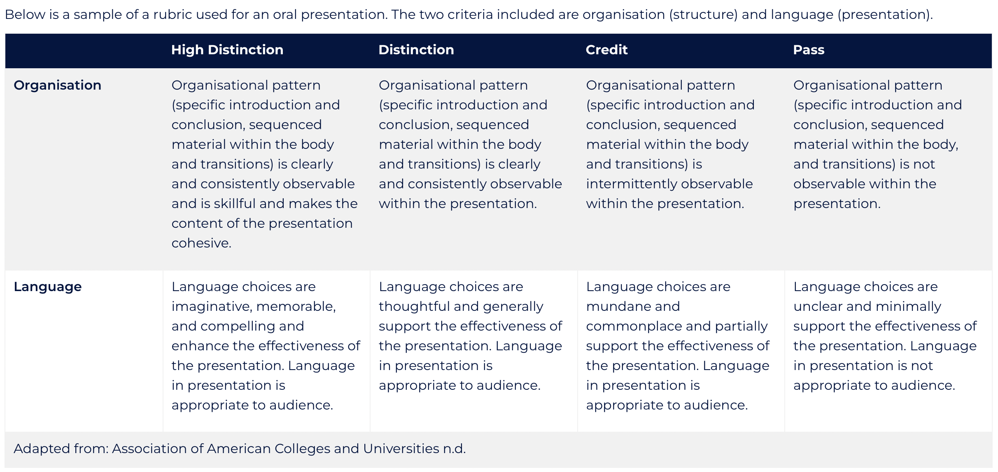
Rubric: Presentation

Slide 34
Rubric: Sonic Artwork (COMP1720)

Slide 35
Rubric: Solo Computer Music Work (COMP4350)

Slide 36
Scoring strategies for code
How do these rubric levels turn into a mark?
Weighted criteria – each criterion carries a percentage (like the programming rubric earlier, and UChicago’s CMSC 12100). Many ANU coding assessments are marked this way.
Automated tests – fast and consistent for correctness, but on their own a weak form of feedback: they tell a student what failed, not why or how to improve.
Strong marking usually combines both – autograders for correctness, human judgement for design, readability and documentation.
Even with a shared rubric, markers often disagree — and disagree with their own earlier marks — so assessor training and moderation matter, not just the rubric (Messer et al., 2025).

Slide 37
Takeaways
Understand (and practice) the tools and approaches for feedback and marking expected in your School or College.
Where possible, ask for guidance or an opportunity to work or mark as a team.
Use available rubrics, criteria documents, task descriptions and standards.
Attend any assessment orientation, benchmarking or moderation meetings organised for the team.
Set a timer for each stage of the process and stick to it!
Take regular breaks to avoid fatigue or getting stuck.
Be selective, deliberate and learning-focused with your feedback.
Be clear about your feedback before assigning a grade or marks.

Slide 38
More Resources
ANU L&T Designing and Using Rubrics
High Impact Teaching Strategies (Victoria State Government)

Slide 39
Questions: Who has a question?

Slide 40

Who has a question?
It’s time for a break so we can remember questions for when we come back or for discussion over tea…
Time for tea.

Slide 41
References

Slide 42
Dawson, P. (2017). Assessment rubrics: Towards clearer and more replicable design, research and practice. Assessment & Evaluation in Higher Education, 42(3), 347–360. https://doi.org/10.1080/02602938.2015.1111294
Messer, M., Brown, N. C. C., Kölling, M., & Shi, M. (2025). How consistent are humans when grading programming assignments? ACM Transactions on Computing Education, 25(4). https://doi.org/10.1145/3759256

