Slide 1
How to be a tutor in the College of Systems and Society
Dr Charles Martin

Slide 2
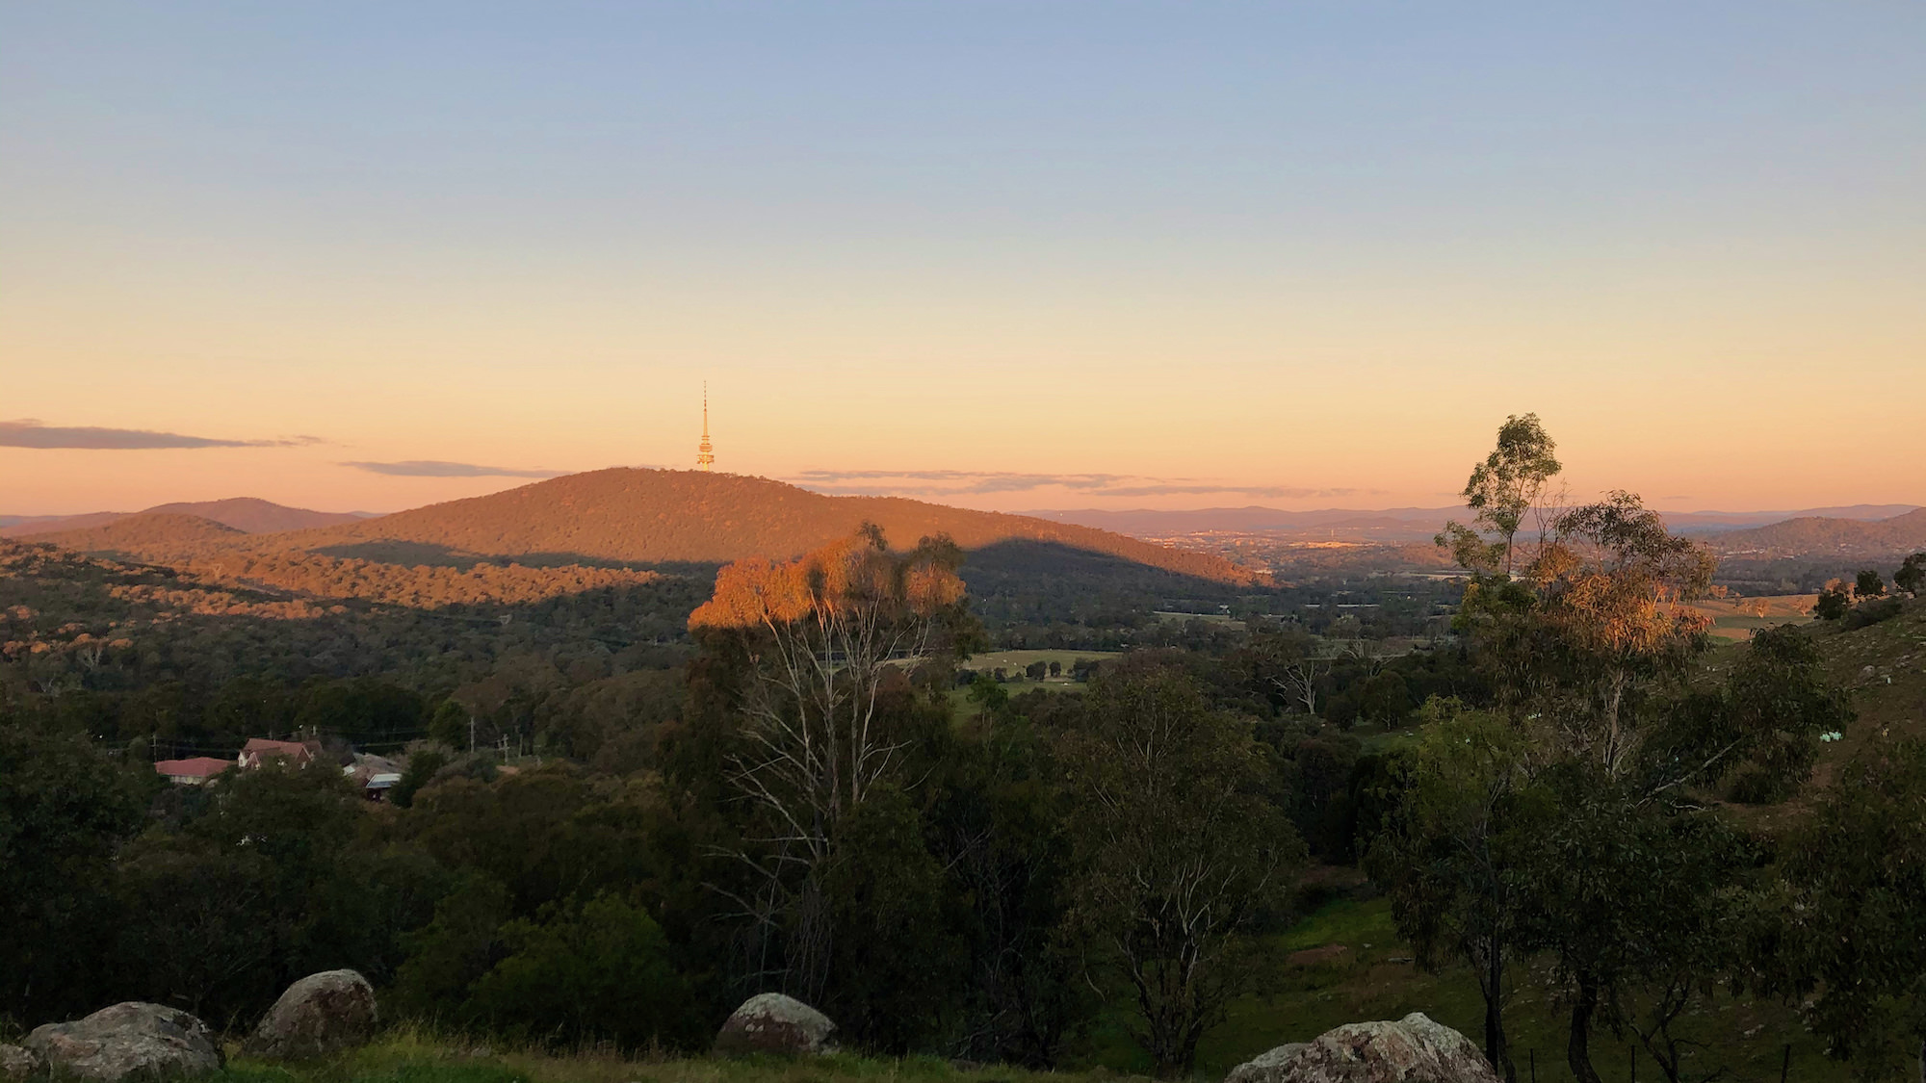
Acknowledgement of Country
Image of Canberra from Mt Painter towards Black Mountain

Slide 3
What are the goals for today?
Admin and Strategies:
Admin: hours, payslips, timetables, who to ask about what
Knowledge: what is teaching about anyway?
Strategies: facilitating labs, marking and feedback, inclusive teaching
Acknowledgements: Many slides here created by members of the former ANU Centre for Learning and Teaching.

Slide 4
Schedule
09:30: 1. How to be a tutor
11:00: Morning Tea
11:30: 2. Facilitating Classes
13:00 Lunch
13:30: 3. Feedback and Marking
15:00: Afternoon Tea
15:30: 4. Inclusive Teaching
17:00: Finish

Slide 5
How to be a tutor

Slide 6
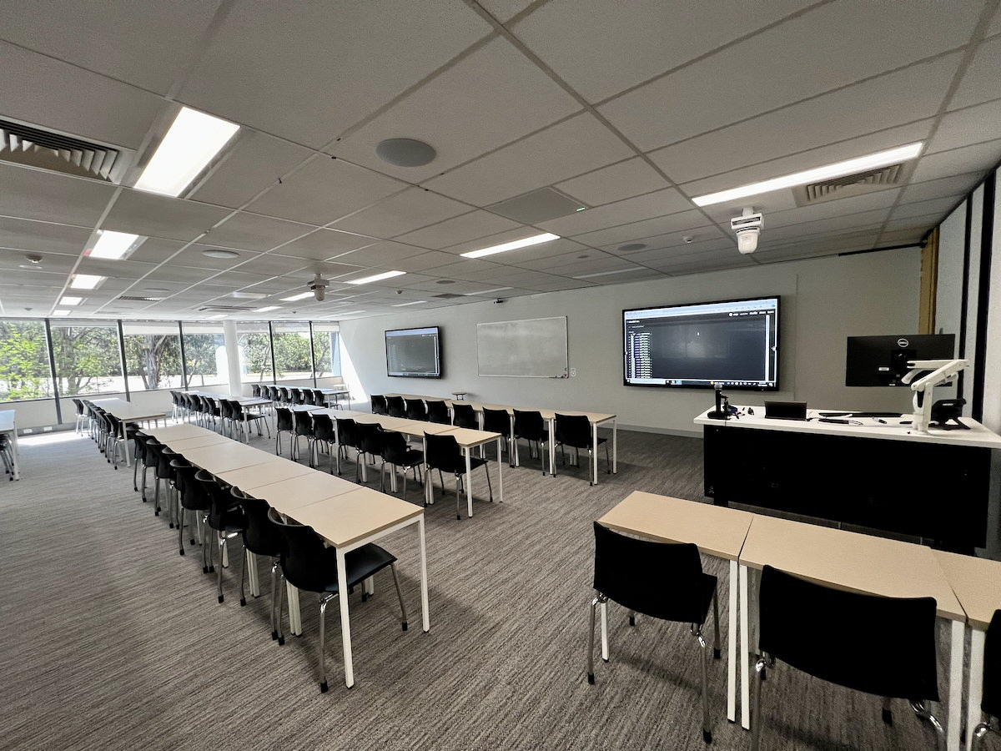
An ANU classroom in the Fulton Muir Building

Slide 7
Task: Journey as an educator (5mins)
Everybody here has experience as a learner but this might be the start of your journey as an educator.
Or you might have had some experiences before… (maybe not as a job!)
Examples: piano teaching kids, coaching soccer team, homework help for high-schoolers, leading a club or society
Who here has had a teaching experience before?
We will discuss examples from the room.
Have you taught before?

Slide 8
What’s tutoring like?
Teaching labs: standing at the front speaking to a whole class, helping individuals with work, answering questions, listening to problems and issues, helping students learn!
Marking assessments: evaluating work (what have students learned?), explaining evaluations, writing feedback, explaining reasoning
Meeting with course convenors and other tutors: going to meetings, understanding duties and tasks, providing ideas/info, incorporating feedback
Filling in timesheets, doing admin: navigating ANU websites, understanding rights/responsibilities at work, asking for help

Slide 9
Qualifications for teaching (new✨)
Why did I have to fill in a docx form?
HESF (Higher Education Standards Framework) expects universities to have teachers with one degree higher than the taught curriculum. Some level of professional equivalency allowed given they have supervision and professional development (PD), e.g.,
PhD students allowed to teach master students
undergrads may teach undergrads provided they have achieved excellent results in the subject
Other examples, see ANUP_016608 S28 Table 2
These rules are not new, but CSS is coming into compliance.
This semester, we learned that the .docx form is unhelpful, ongoing process to replace this.
Professional development: training at the start 😇, refresher session every year 👩🏽‍🏫

Slide 10
Timesheets, hours, and earnings codes
Every two weeks you will need to fill in a timesheet on HORUS (the ANU HR website). Tricky because of way ANU accounts for teaching hours through “earnings codes” where 1 unit of the code may include more than 1 hour of work.
T42: Marking: 1-to-1 ratio
T44: “Other required activity”: 1-to-1 ratio
T21: Teaching “Supplementary / scaffolded form of delivery” (that is, tutorials or labs): 1-to-3 ratio (1 hour teaching + 2 hours of “associated working time”)
T23: Repeat Teaching “Supplementary / scaffolded form of delivery” (1 hour teaching + 1 hour associated working time)
Source: ANU Academic Casual Sessional Rates

Slide 11
What is associated working time?
ANU Enterprise Agreemtns S2.5—S2.6
Preparing of teaching activities
Contemporaneous marking
Administration directly associated with a teaching activity
Face to face consultation immediately prior to and following a face to face teaching activity
Online consultation (e.g. email, messages, forums) immediately prior to and following an online teaching activity
Attendance at meetings specifically for the purpose of assisting the CSA staff member to prepare for their teaching activity

Slide 12
Contemporaneous marking (new✨)
ANU Enterprise Agreement 2023–2026 S2.6
S2.6:
For the purposes of this provision, ‘contemporaneous marking’ means marking that is performed during a teaching activity, or marking work that could have reasonably been performed during the teaching activity, for example, marking oral presentations delivered during class.
so what does “reasonably performed during the teaching activity” mean?

Slide 13
Why do we do it this way? (new✨)
teaching to associated work time ratios are set out in the Higher Education Industry—Academic Staff—Award 2020 16.4¹
tasks for associated working time are in the Enterprise Agreement
provides guarantees of hours throughout the semester
protects casual staff against unfair requests from academics (e.g., “You’ll have to attend the lecture to find out what to teach! No you don’t get paid for that!!”)
provides an automatic allowance for preparation, Q&A and admin work.
Your manager needs to provide tasks for you to complete in Associated Working Time.

Slide 14
A worked example:
Code | Units | Teaching Time | Associated Working Time | Total Hours Worked/Paid
T21 Teaching | 1.5 | 1.5 | 3 | 4.5
T23 Repeat Teaching | 1.5 | 1.5 | 1.5 | 3
T42 Marking | 3 |  |  | 3
T44 Other | 1 |  |  | 1
Charles the tutor teaches two 1.5-hour labs, 3 hours of work (preparation, marking, admin, consultation and meetings) related to those labs,
3 hours of marking assignments,
and 1 hour writing test cases for the exam.

Slide 15
School of Computing: 1.5 + 0.5 structure
In the School of Computing, many of our classes have a 1.5 hour teaching + 0.5 hour drop-in individual consulting structure.
Computer Lab: 1.5 hours (T21/23 teaching)
Drop-in: 0.5 hours (taken from the associated hours)
Charles advice:
At the end of 1.5 hours announce “the tutorial is now over, I am staying until X o’clock to answer individual questions.”
Answer questions about any aspect of the course (redirect problem questions to the forum and help the student to write and submit the post).
Don’t do any group teaching in consultation time.

Slide 16

Submitting your timesheet
Submit your timesheet on time. (please!!)
Suggested submit date is the last Sunday in each two-week pay period. Actual due date can change due to public holidays.
And double check that you get paid!
Timesheets FAQ
Photo by Joshua Olsen on Unsplash

Slide 17
Safety: What to do if something bad happens?
⚠️⚠️⚠️
Threats of harassment, bullying, violence (interpersonal, psychological, sexual or physical) or disrupting classes completely not acceptable—and not your job to resolve!
⚠️⚠️⚠️
Prioritise your safety. Just walk out.
You are in control of your class, if you feel unsafe walk out!
go to a safe place (e.g., Skaidrite Darius Front Office)
call ANU security: 61252249 or ANUOK App

Slide 18
Emergency Buttons and Phones
Skaidrite Darius labs have a red panic button on the wall near the door: ANU Security will visit immediately if the button is pressed.
Life threatening emergency call 000 from your phone or 0000 from an ANU Phone, then call ANU Security 61252249 (52249 from internal phone).
Link: ANU Safety Website

Slide 19

Where to get help
Other tutors: course team / communication channels (varies by course)
Course Convenor (your direct manager)
School of Computing front desk (Skaidrite Darius Level 3 or admin.comp@anu.edu.au)
Peter Hoefner - Associate Director (Education) in School of Computing: adir.education.comp@anu.edu.au
me - Assistant to the above - also adir.education.comp@anu.edu.au
Photo by Matthew Waring on Unsplash

Slide 20
Working with convenors
Communicate:
Your convenor is your main “boss” and contact point for your job.
You will need to learn about how they operate.
Dynamic can change! Work instructions are different to learning suggestions: e.g., how much time to spend on a task.
Listen, observe, be understanding:
Academics are… all really different!
Convenors can get stressed: budgets, plagiarism, appeals, marking, deadlines and this is only 40% of our job!
If you aren’t getting a reply consider: Are they trying to write their book? Are they at a conference?

Slide 21
Developing as an educator

Slide 22
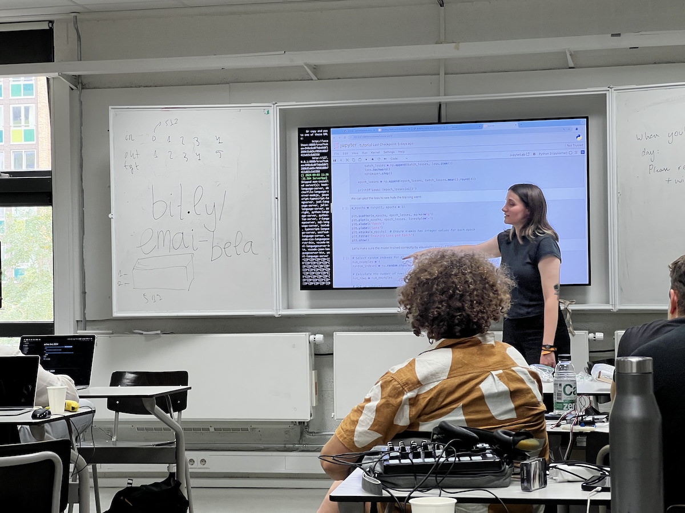
Teaching at a workshop

Slide 23
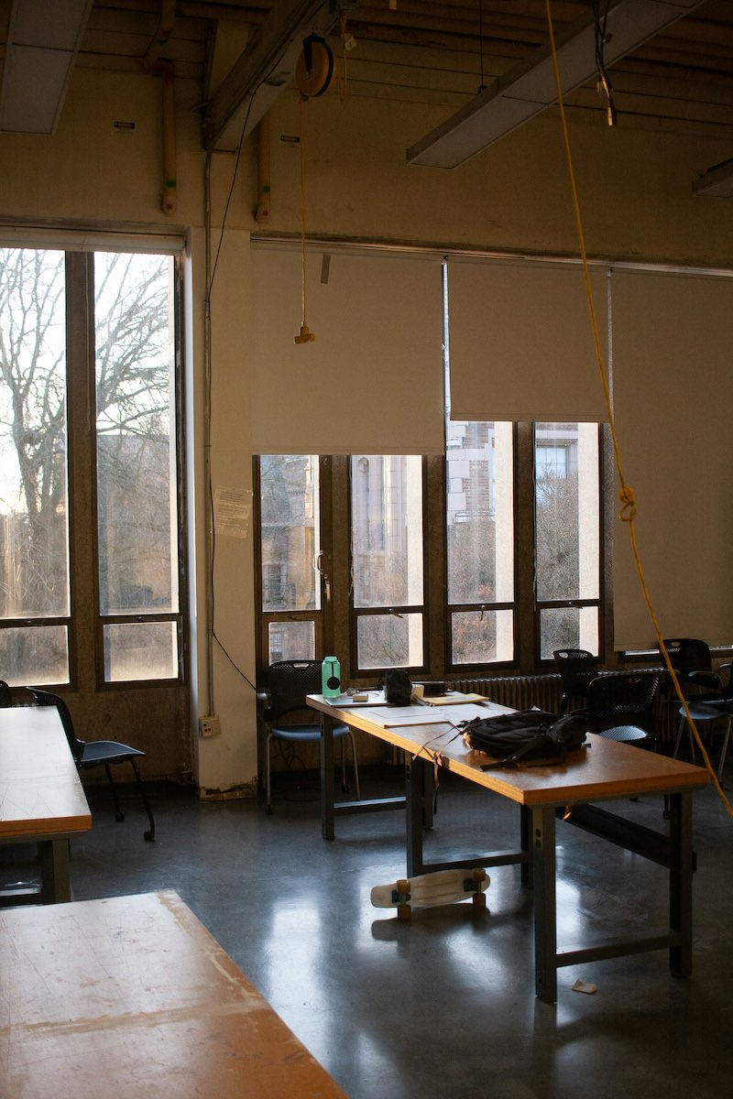
Am I expected to know everything on the first day?
Of course not!
Teaching is a craft, we learn by doing.
As a tutor you have a well-defined role, lots of resources, and support.
Not expected to be perfect on day 1, or even day 100.
We’re going to talk about developing as an educator.
Photo by David Schultz on Unsplash

Slide 24
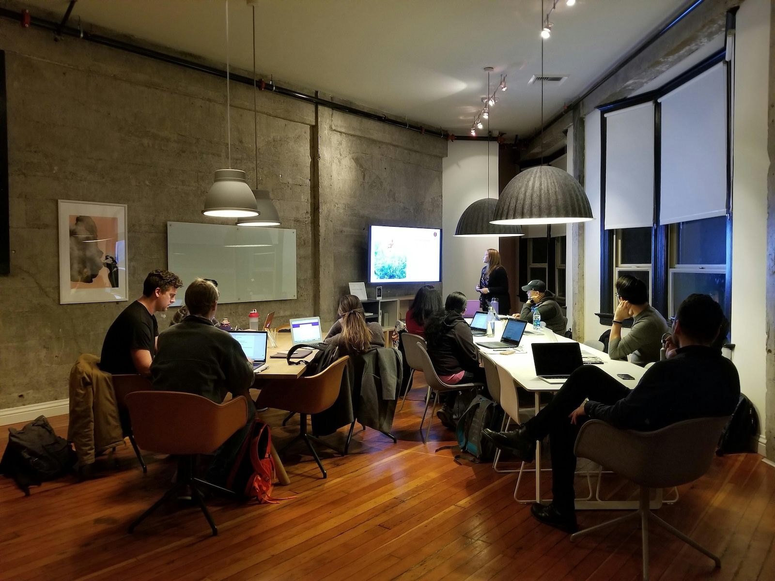
Task: Getting to know you as a learner (5mins)
Reflect on your teaching experiences, expectations and learning needs.
Select three sticky notes from your table and answer these three questions:
What do you enjoy or expect to enjoy about tutoring?
What challenges have you faced or do you expect to face as a tutor?
What aspects of tutoring would you most like support with?
Discuss with your group and then we’ll hear one example of each question from each table.
What are your expectations about tutoring?

Slide 25
How do people develop as teachers?
Kugel (1993) describes one pathway of development as university teachers:
Self
Subject
Student…
As educators we also learn and are influenced by our environment, experiences, and self.

Slide 26

Phase 1: Emphasis on Teaching
Focus on self: Survival in front of a class! Learning how to explain, fear of not knowing the “right” answers.
Focus on subject: Covering the topic thoroughly (more than a student!). Preparing packaged, inspiring, and interesting content. Fear of running out of time!
Focus on student: Students are different! Prepare alternatives formulas and explanations. Learn about student needs, awareness of multiple valid approaches.
A teacher up the front

Slide 27

Phase 2: Emphasis on Learning
Student as active: Let students do the work! Coaching students in applied learning activities. Teaching less, but more learning occurs.
Student as independent: Coach students in learning how to learn. Let students independently explore. (What knowledge will be important in computing in 20 years?)
Tuning: Established skills in previous stages. Move between stages as necessary, updating and experimenting.
A teacher at the side

Slide 28
Risks
Early stages:
Great content, students not engaging and not learning.
Overwhelm students with explanations: answering questions not asked.
Frustrating when student don’t find this fascinating topic interesting!
Later stages:
Getting students to do things: tricky.
Teaching less doesn’t mean nothing: still need telling/showing (explicit teaching).
Need to do listening and questioning: these are hard skills.
Students annoyed! “Just tell me what to do!!”

Slide 29

Task: What stages resonates for you?
Think about the phases/stages of teaching described in Kugel (1993)
Focus on self
Focus on subject
Focus on student
Student as active
Student as independent
Tuning
What stages resonate for you and why? Where are you on your teaching journey?
Discuss in your groups and we will come together to hear some responses.
What kind of a teacher will you be this semester?

Slide 30
Questions: Who has a question?

Slide 31
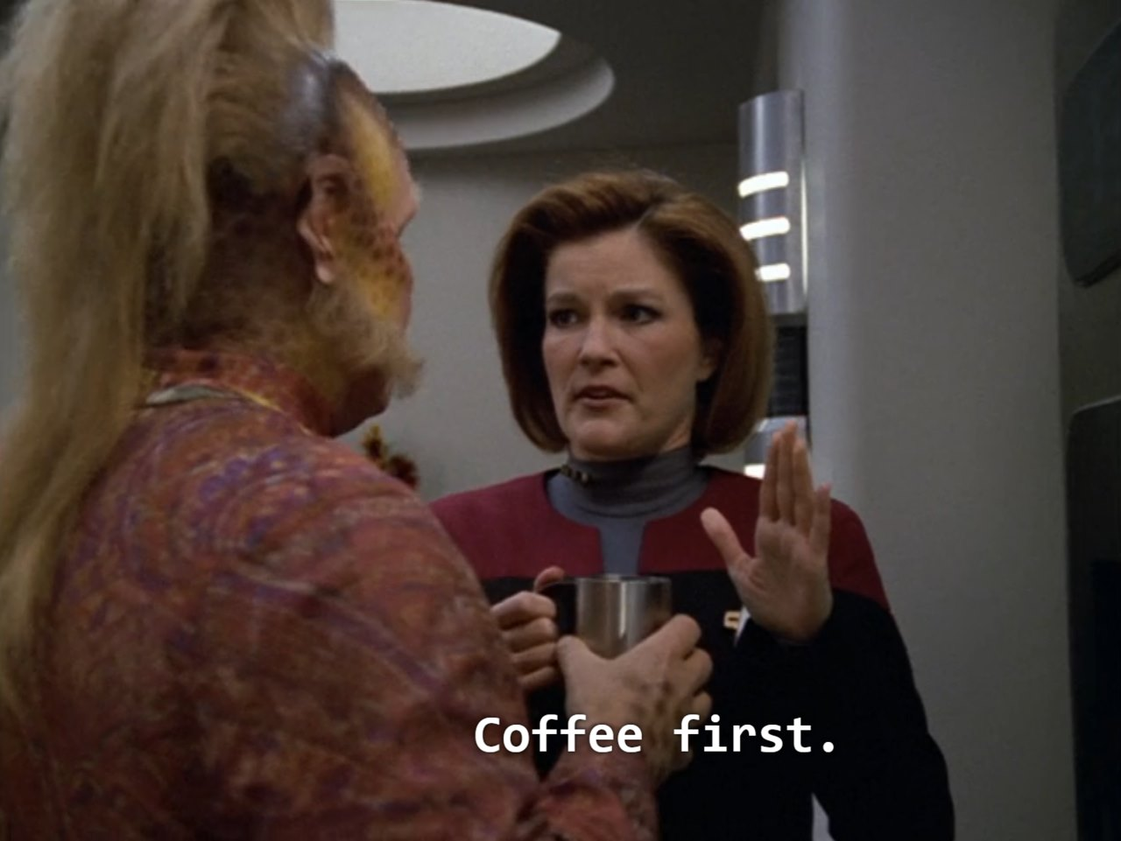
Who has a question?
It’s time for a break so we can remember questions for when we come back or for discussion over coffee…
Time for coffee.

Slide 32
References

Slide 33
Kugel, P. (1993). How professors develop as teachers. Studies in Higher Education, 18(3), 315–328. https://doi.org/10.1080/03075079312331382241

Slide 34
Notes
1. so Federal Government level rules

